Slide 1
UE19CS390B – Capstone Project Phase – 2
Project Progress Review #1
Project Title : Automated Billing cart
Project ID : 75
Project Guide : Prajwala T.R
Project Team :
PES2U1G9CS198 Kuntal Gorai
PES2UG19CS346 S V S C Santosh
PES2UG19CS391 Skanda S
PES2UG19CS454 Vijay Murugan A S

Slide 2
Outline
Abstract and Scope of the Project
Capstone Project Phase – 1
Summary of work
Inferences drawn from Literature Survey
Expected Deliverables
Gantt chart

Slide 3
Abstract and Scope
Shopping malls have become an integral part of city life and a lot of people commute to these marts to get their daily essentials and groceries. However, we are all forced to go through the tedious task of getting our items billed. The billing phase is the one choke point every customer must pass through. Moreover, every customer takes a variable amount of time to get their items billed, causing huge queues. We aim to make this whole experience of shopping easier.

Slide 4
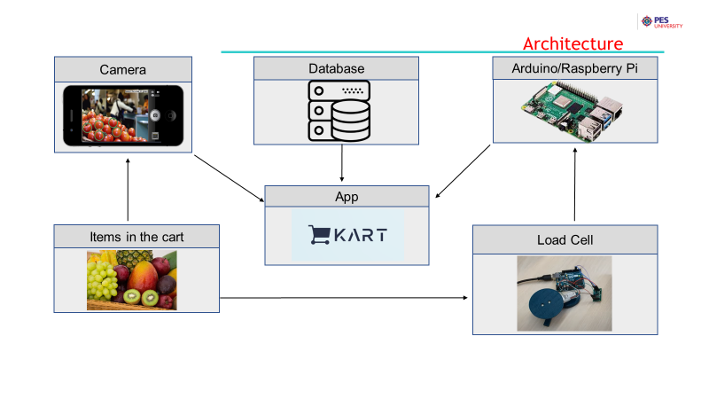
Architecture

Slide 5
Summary of Work Done in Capstone Project Phase - 1
Deciding the problem statement
Literature Survey
Accumulated a good portion of the dataset
Implemented a simple deep learning model to explore about transfer learning
High Level Design
We were suggested to limit our project to just the billing part where a final bill is generated and not thinking about payments.

Slide 6
Expected Deliverables
List of tasks: (Completed)
Collecting Good quality Dataset.
Decide on final structure in which data needs to be given to the model to work.
Augmenting the data.
Decide on the deeplearning models which can be used.
Use ensemble learning by integrating multiple models together.
Train all the models on Collab using the same data.
Convert the models into a necessary format to be integrated with android studio Based app.
Make necessary changes in Java to use the Deep learning models developed and ensure consistency between the two.

Slide 7
Expected Deliverables
List of tasks: (Pending)
Determine the UI of the app as to what all pages are needed and how to design the same.
Decide on what and how database can be used to ensure all apps work with same data.(prices)
Ensure efficient working of the Hardware IO components.
Integrate app with Hardware IO components.
Make necessary Changes to ensure user-friendliness and ease of use.
Testing the efficiency and accuracy of the app.

Slide 8
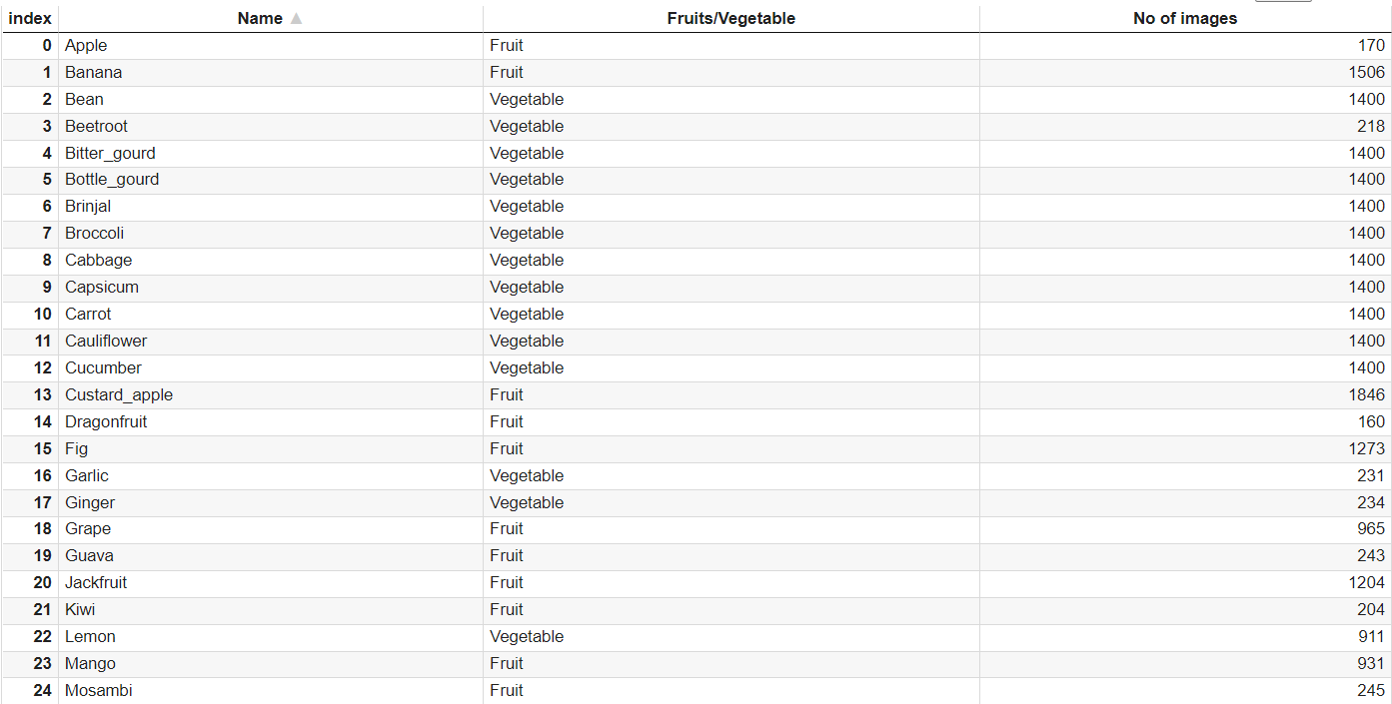
Expected Deliverables
Data Collection: Data Frame showing Necessary Information

Slide 9
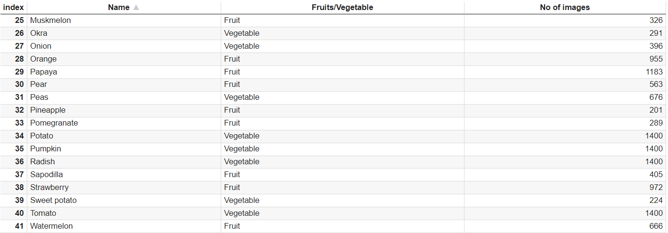
Expected Deliverables
Data Collection: Data Frame showing Necessary Information

Slide 10
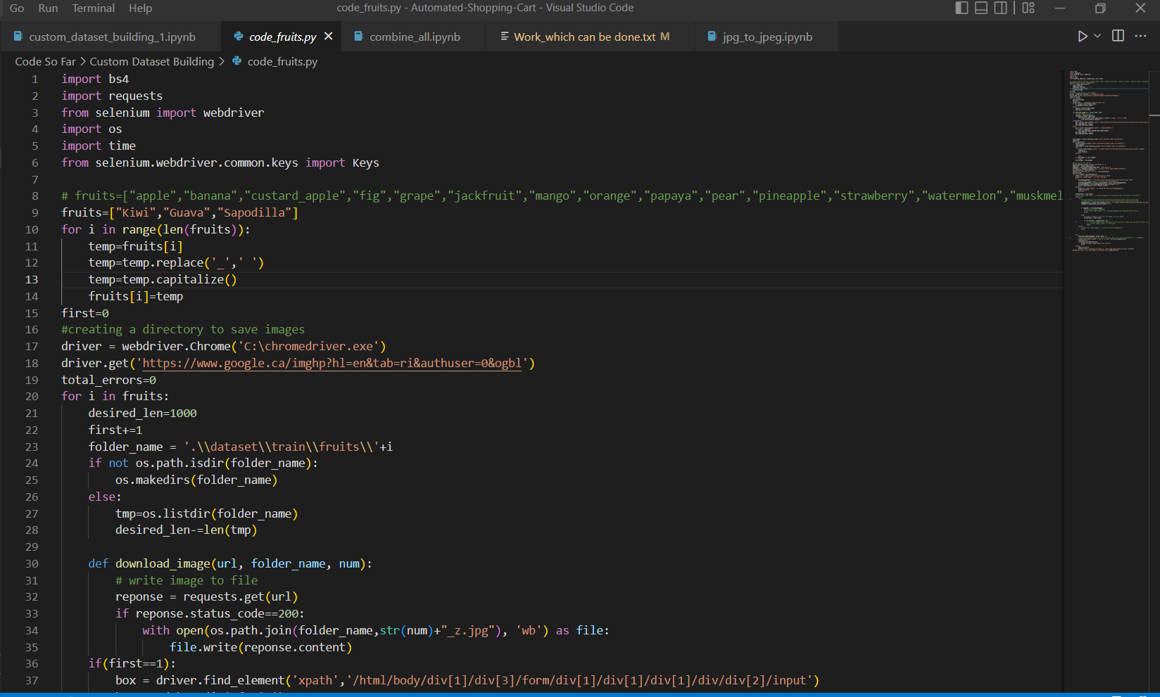
Expected Deliverables
Data Preparation: The Dataset Currently being used has been obtained by Manual downloading images from website <images.cv> and later we have extended the same for new classes which could not be found by writing a python code which scrapes the google images search of the class of fruit or vegetable needed and downloads high resolution images of the same automatically until the desired number of images are obtained or the search results exhaust.

Slide 11
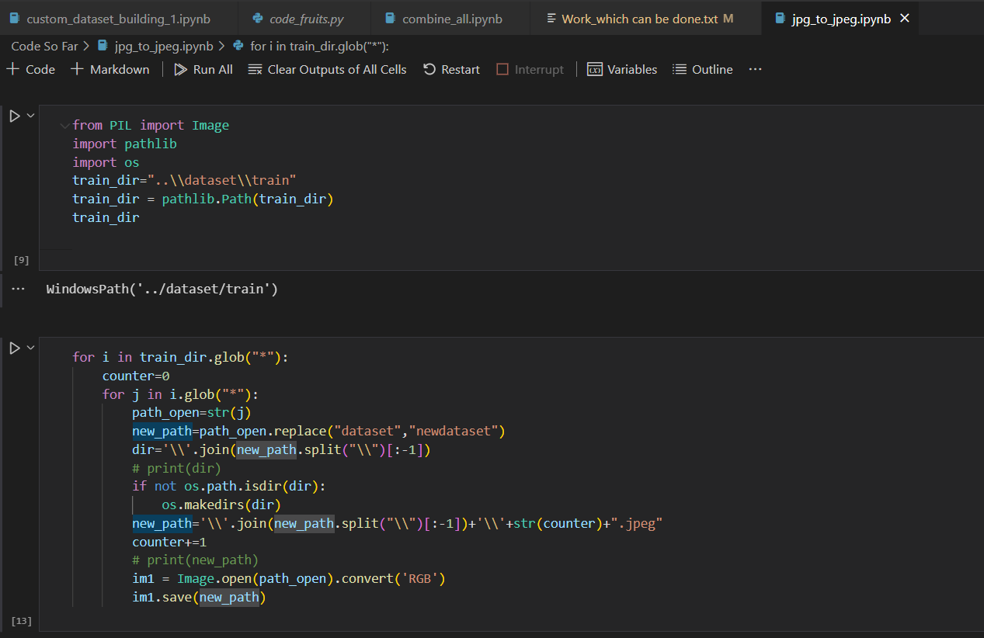
Expected Deliverables
Data Pre-processing: The images downloaded have different formats some of which might not be acceptable to be taken in as input to the model and the images downloaded do not have RGB pixels for all images so necessary conversions to .jpeg, .jpg, .png had to be done in addition to filter junk images coming out of google image search.

Slide 12
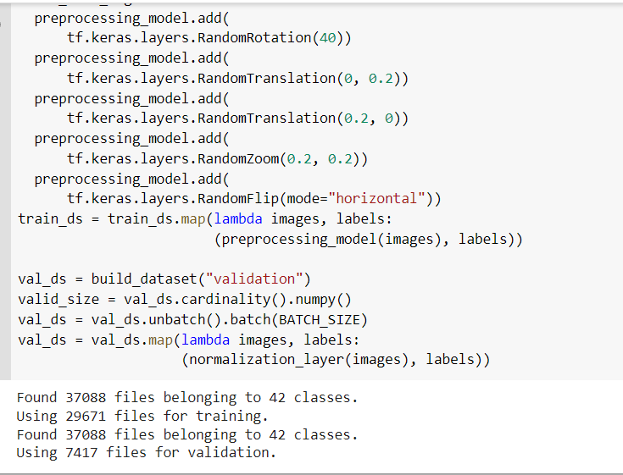
Expected Deliverables
Data Input: The model like any other Transfer Learning model takes input of the image converted into any image of fixed size like 224*224 for Efficient Net, Mobile Net etc. The Data being used undergoes some Augmentation like Rotation of images by some degree, zoom in ,zoom out. After this the input is sent as a numpy array of RGB values.

Slide 13
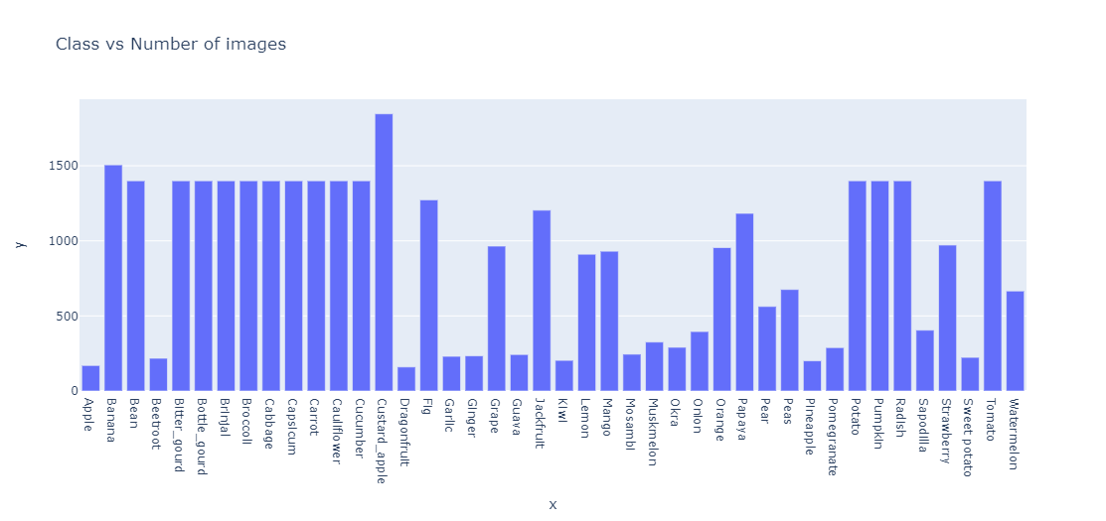
Expected Deliverables
Data Visualization: Images vs Class

Slide 14
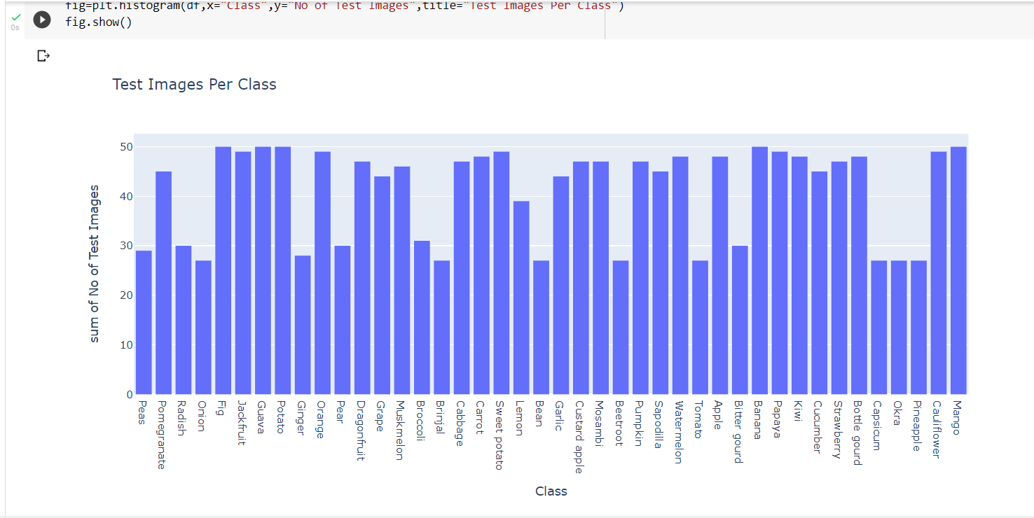
Expected Deliverables
Data Visualization: Test Images vs Class

Slide 15
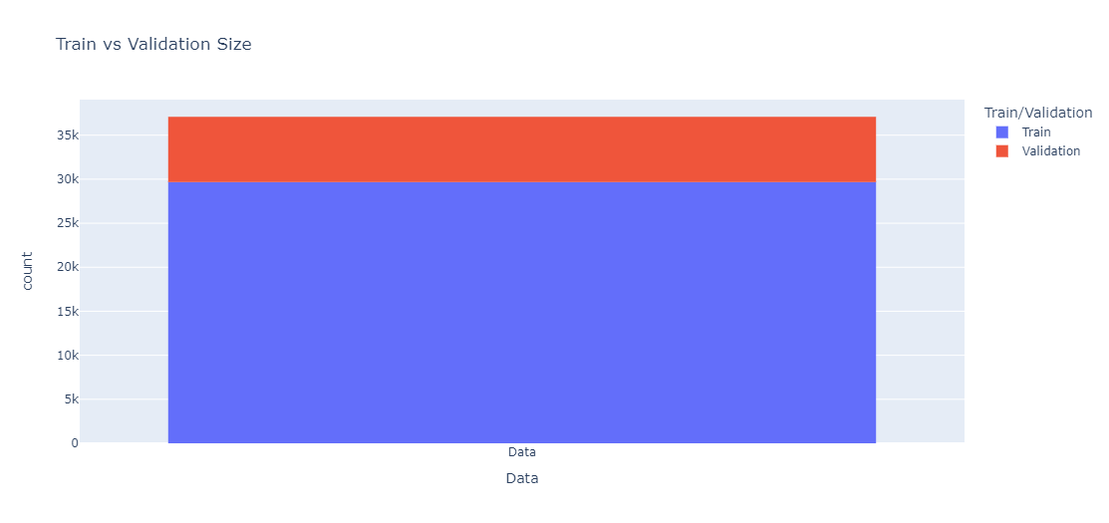
Expected Deliverables
Data Visualization: Images vs Class

Slide 16
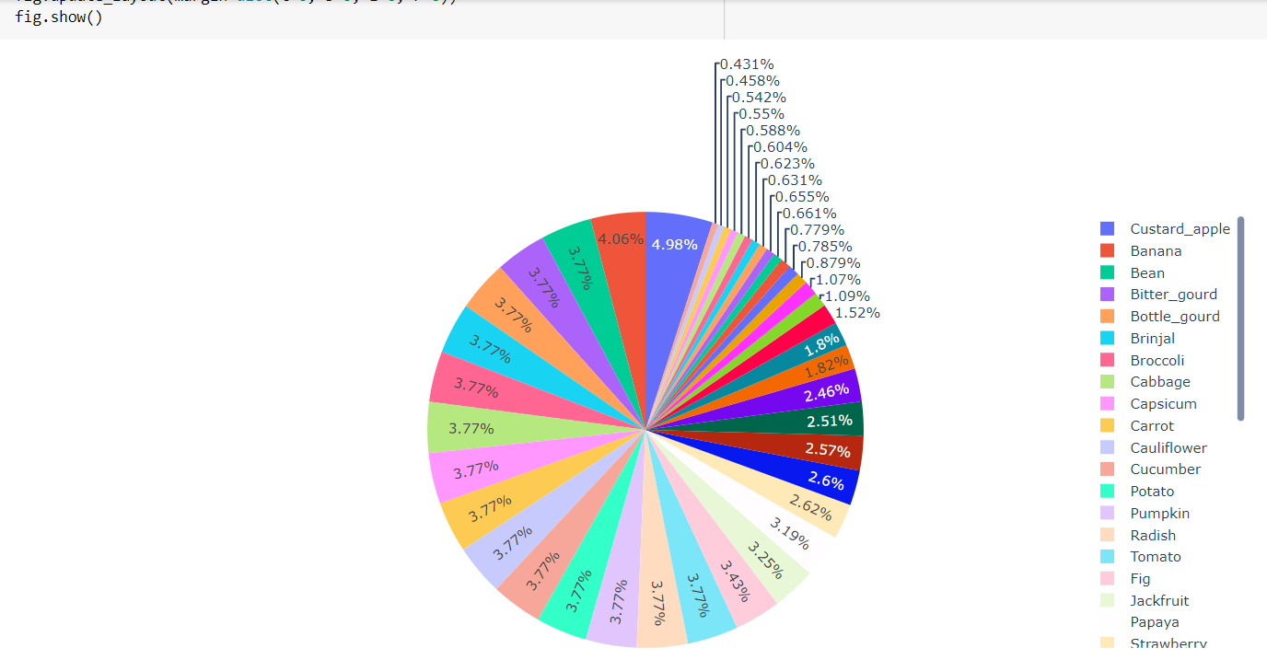
Expected Deliverables
Data Visualization: Percentage of Classes

Slide 17
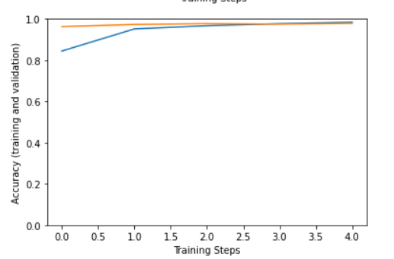
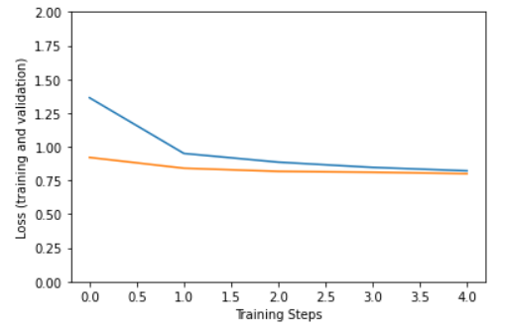
Expected Deliverables
Data Visualization: Efficient Net V2
Training and Validation Accuracy
Training and Validation Loss

Slide 18
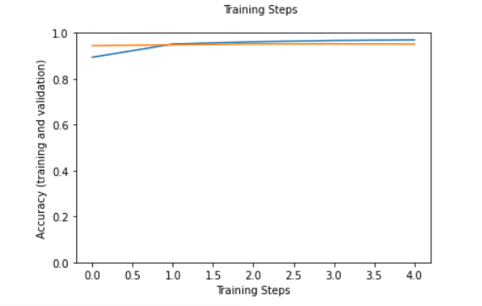
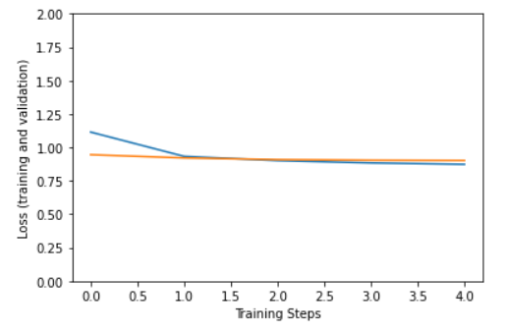
Expected Deliverables
Data Visualization: Mobile Net V2
Training and Validation Accuracy
Training and Validation Loss

Slide 19
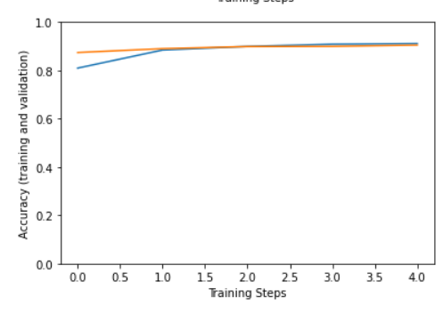
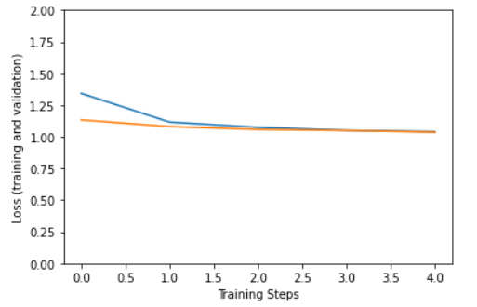
Expected Deliverables
Data Visualization: NasNet_Mobile
Training and Validation Accuracy
Training and Validation Loss

Slide 20
App Demo Link
https://youtu.be/TDk_VeCxuBE

Slide 21
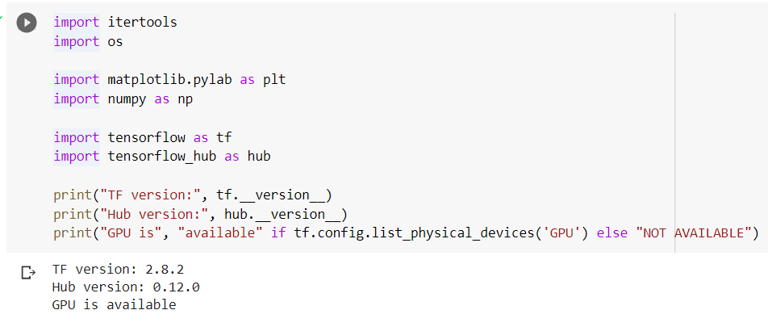
Expected Deliverables
Data Interpretation: One major conclusion which can be drawn when working on data related to multi class classification is that the quality of images in dataset play a major role in determining the accuracy of the final model developed.
Storage : Data is stored in the convenient file system structure enabling the classes to be easily distinguished. Currently The Entire Dataset is stored on Google Drive as a zip file as it allows easy extraction and working with Google Colab which is being used currently to train our models at a higher speed for higher number of epochs on GPU.

Slide 22
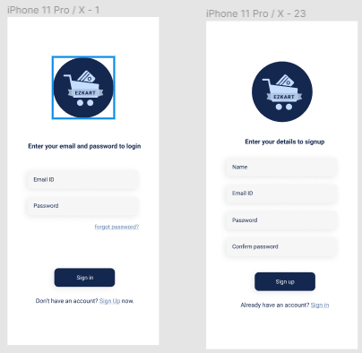
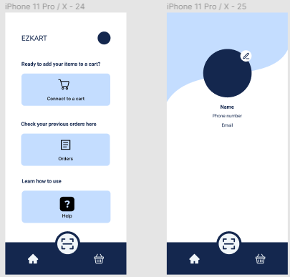
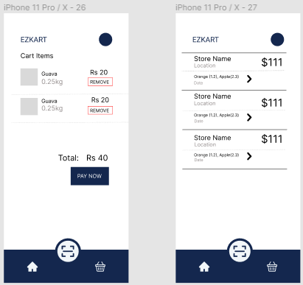
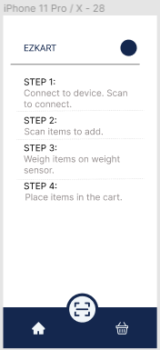
Expected Deliverables
Tentative UI of the app:

Slide 23
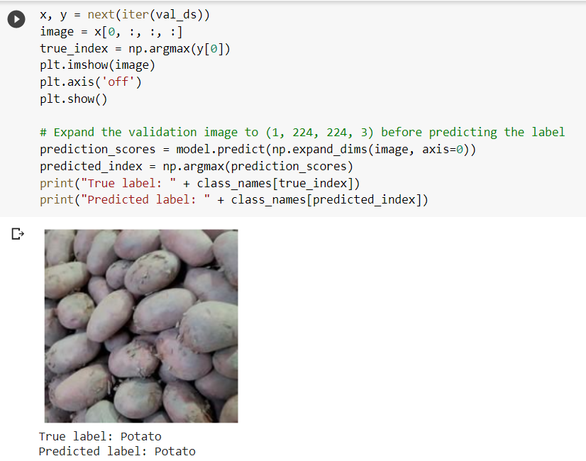
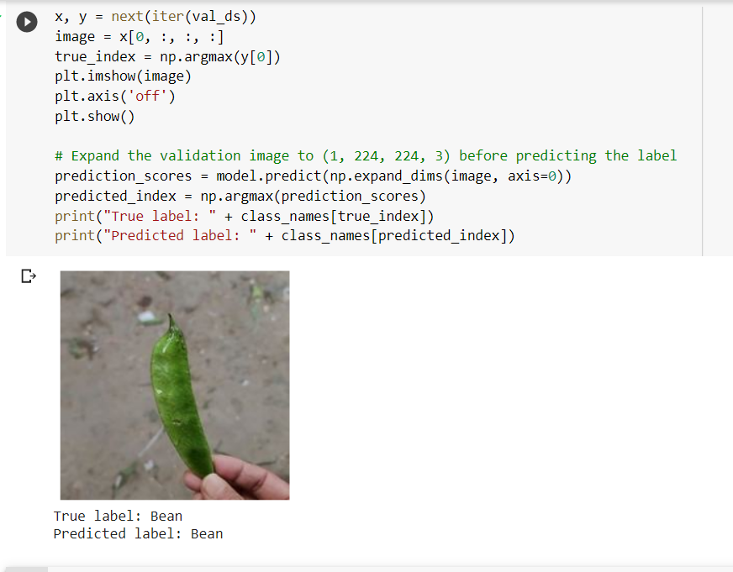
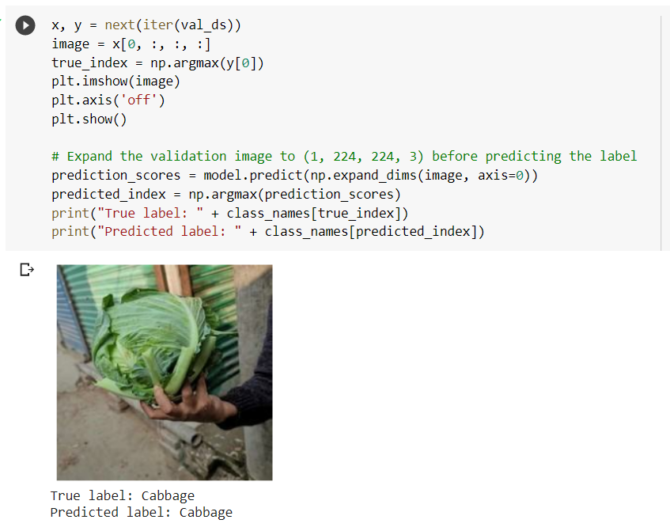
Expected Deliverables
Testing for the module that is completed: Efficient Net_V2

Slide 24
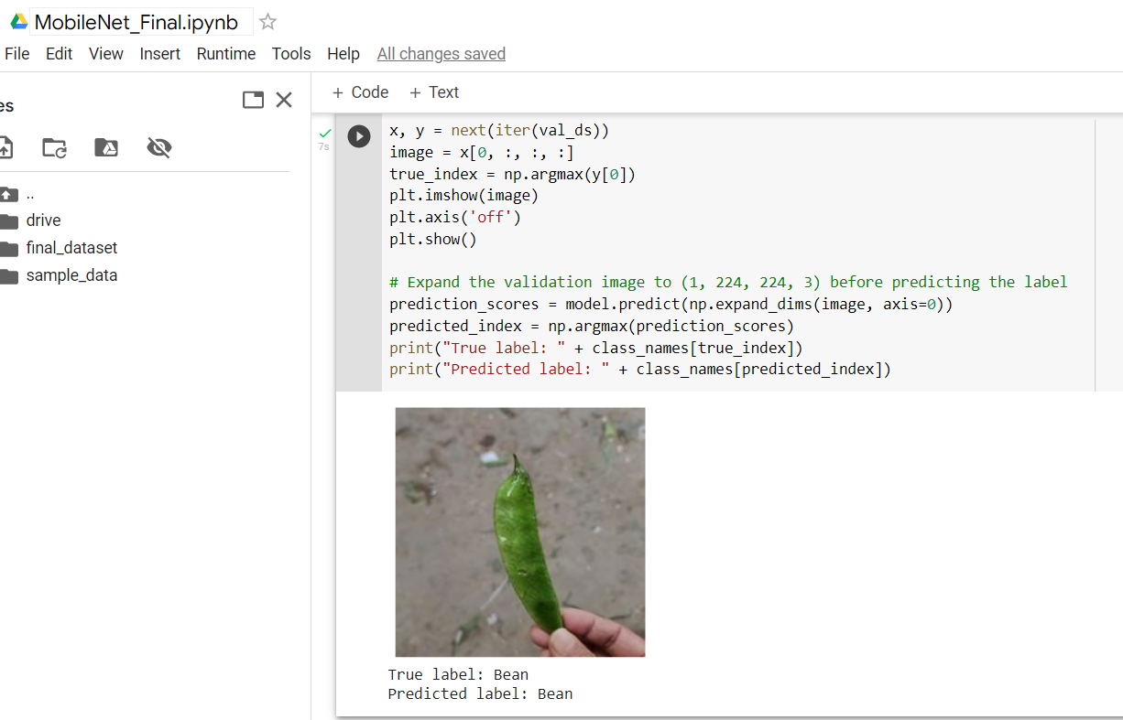
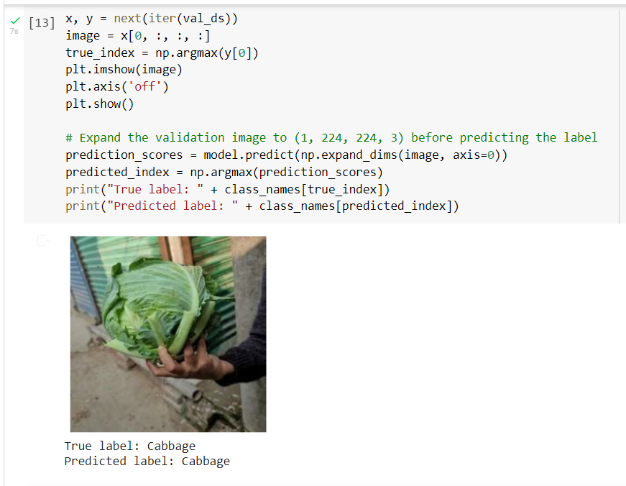
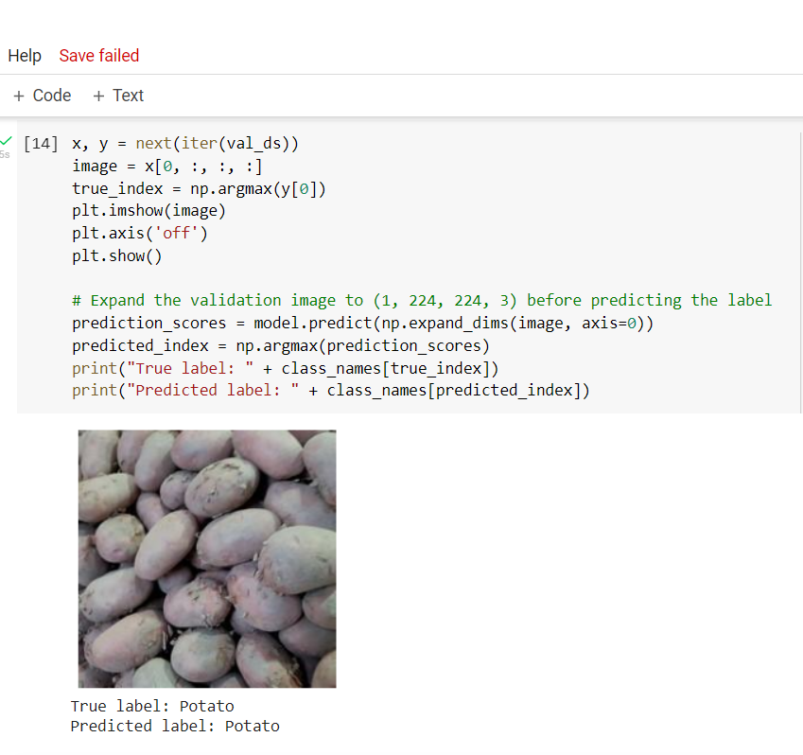
Expected Deliverables
Testing for the module that is completed: Mobile Net_V2

Slide 25
Expected Deliverables
Demonstration and Result of modules completed.
The developed app with the integrated ML models were tested for real-time images and achieved good results.
Based on the accuracy achieved in each model with and without augmentation we took the three best models and performed ensemble learning which gave a final accuracy of 0.70 for 50 test images for each class.
Model(Testing Accuracy) | With Augmentation | Without Augmentation
EfficentNetv2 | 0.69 | 0.67
MobileNetv3 | 0.64 | 0.56
Nasnet_Mobile | 0.64 | 0.62

Slide 26
Expected Deliverables
​
Tabulate the timeline for all the tasks/modules.
Sl no | Task | Start Date | End Date
1 | Building Good quality Dataset. | 10-04-2022 | In Progress
2 | Deciding on Deep Learning models | 15-06-2022 | 19-06-2022
3 | Training the models | 20-06-2022 | 13-07-2022
4 | Implementing models on the app | 15-07-2022 | 25-07-2022
5 | Testing the working | 26-07-2022 | 30-07-2022
6 | Design on the app | 01-08-2022 | 09-08-2022

Slide 27
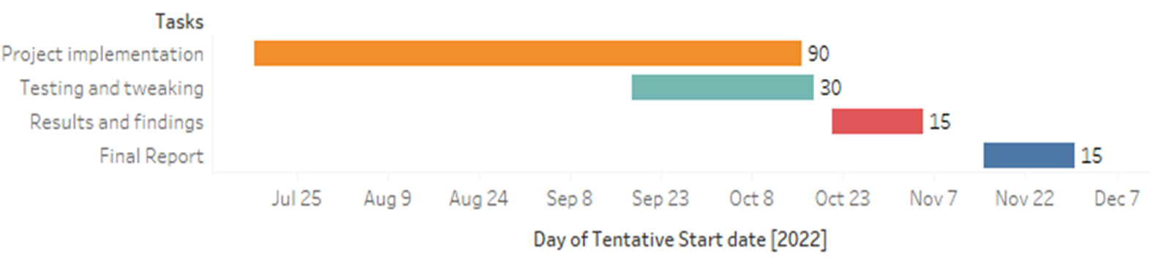
Gantt Chart

Slide 28
Expected Deliverables
List the SDK / API / Model / Jar/ DLL / Tools / Technologies used – Open-Source/ Licensed.
Android Studio to develop the application.
Google Colab / Jupyter Notebook.
TensorFlow, Keras to develop the model.
Selenium for dataset collection.
VGG-16, MobileNet V2, NAS Net, Efficient Net.
TensorFlow Hub

Slide 29
Expected Deliverables
Individual contribution of the team members
SRN | NAME | Task Assigned | Time Spent
PES2UG19CS198 | Kuntal Gorai | Build the Necessary Models, Dataset Collection, Dataset Structure Finalization. | 60 Hrs
PES2UG19CS346 | SVSC Santosh | Integrate Models with app, Dataset Collection, Dataset Structure Finalization. | 60 Hrs
PES2UG19CS391 | Skanda S | UI Design, Dataset Collection, Explore Transfer Learning with VGG 16. | 60 Hrs
PES2UG19CS454 | Vijay Murugan AS | UI Design, Dataset Collection, Explore Transfer Learning with VGG 16. | 60 Hrs

Slide 30
References
Deployment of Deep Learning Models on Resource-Deficient Devices for Object Detection Ameema Zainab & Dabeeruddin Syed - 2020
A Hierarchical Grocery Store Image Dataset with Visual and Semantic Labels Marcus Klasson, Cheng Zhang & Hedvig Kjellstrom - 2019
Android Application for Grocery Ordering System Shubham B Dubey, Gaurav M Kadam & Omkar Angane - 2021
Fruit Classification for Retail Stores Using Deep Learning Jose Luis Rojas-Aranda, Jose Ignacio Nunez-Varela, J. C. Cuevas-Tello & Gabriela Rangel-Ramirez - 2020
5. Cross Validation Voting for Improving CNN Classification in Grocery Products ,
Jamie Duque Domingo , Roberto Medina Aparicio , and Luis Miguel Gonzalez Rodrigo - 2022

Slide 31
Thank You

